Slide 1
Concealment Portfolio 3.5 Experimenting as a photographer
-Lily Prosser

Slide 2
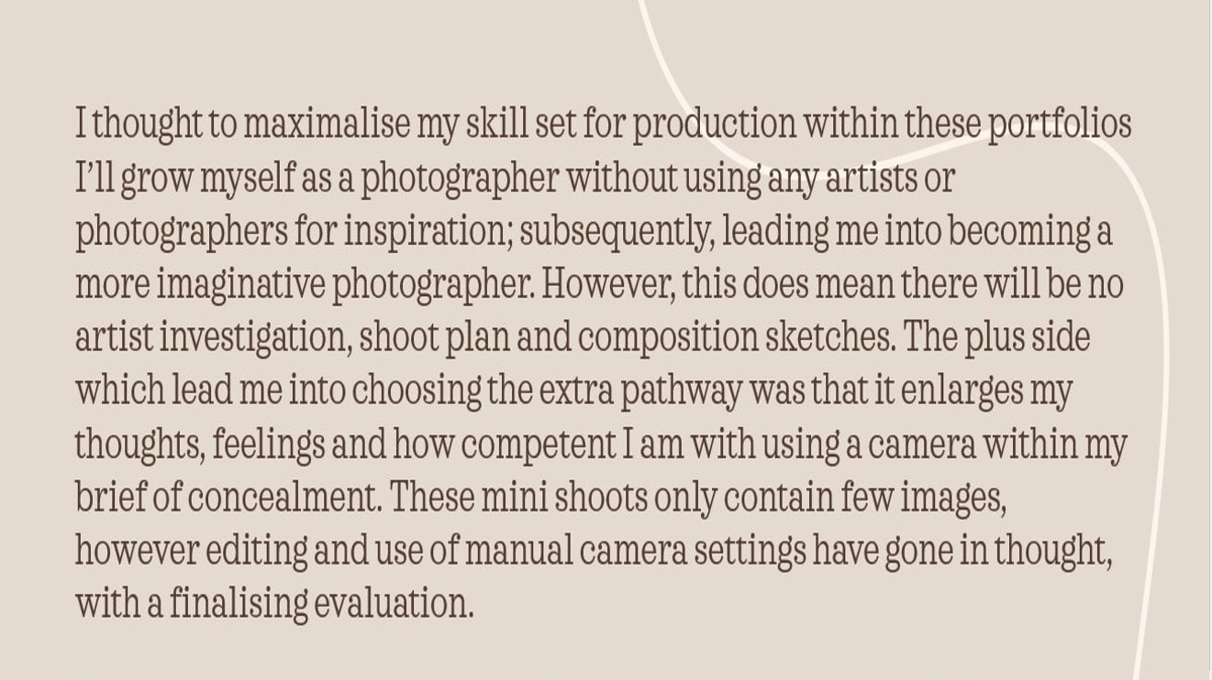

Slide 4
