Slide 1
CONCEALMENT PORTFOLIO 4.5 EXPERIMENTING AS A PHOTOGRAPHER
- Lily Prosser

Slide 2
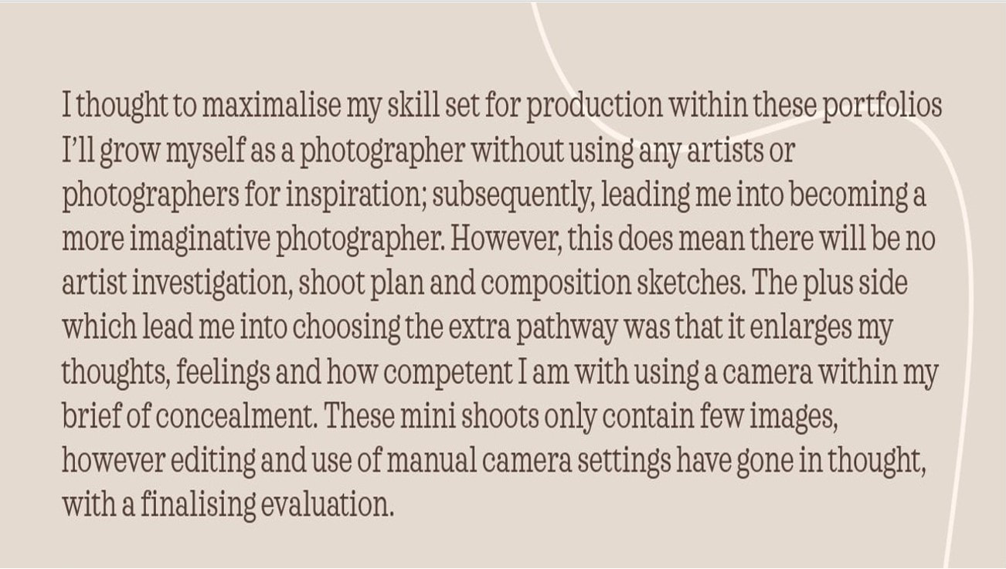

Slide 3
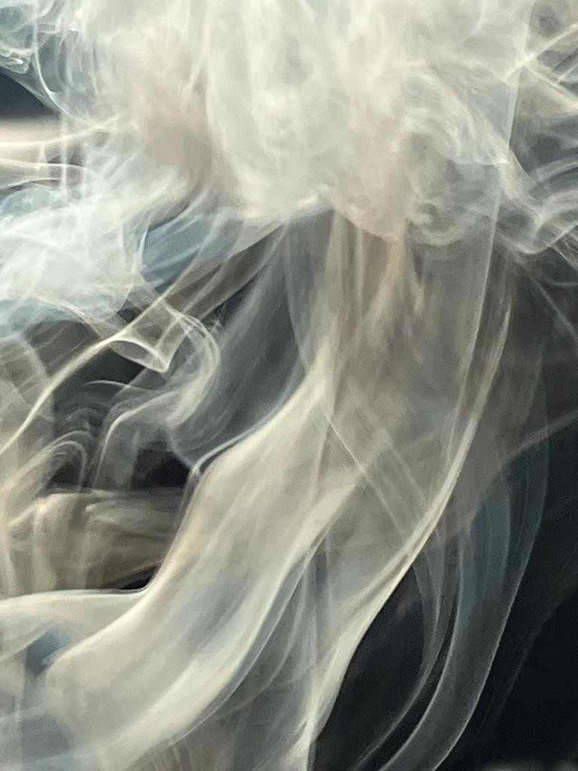
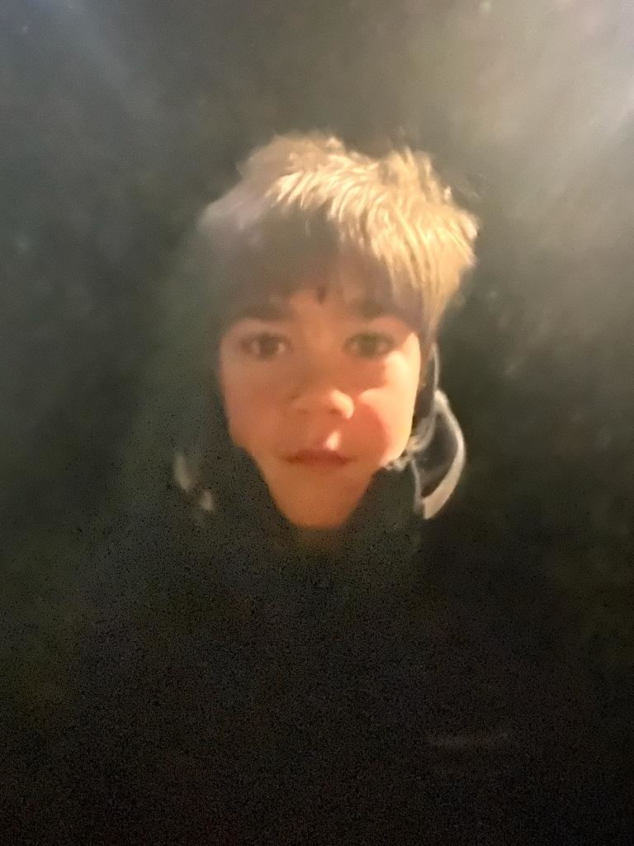
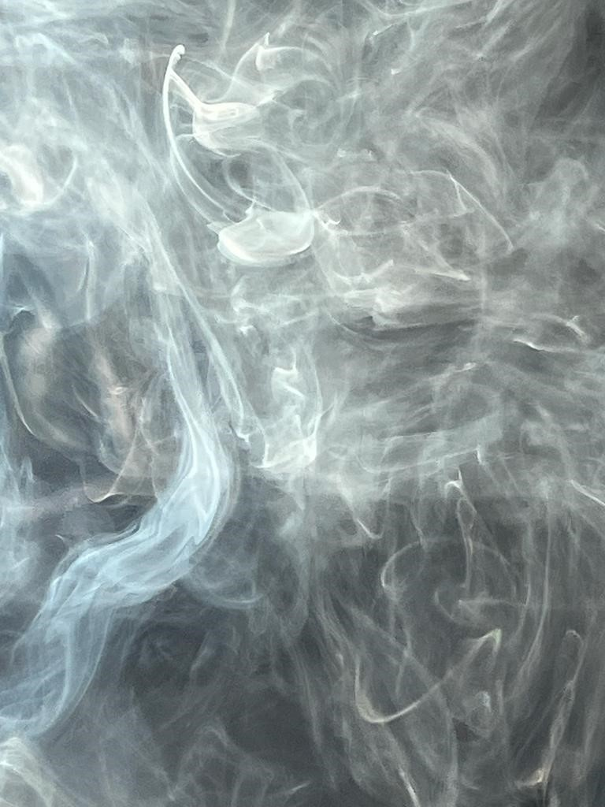
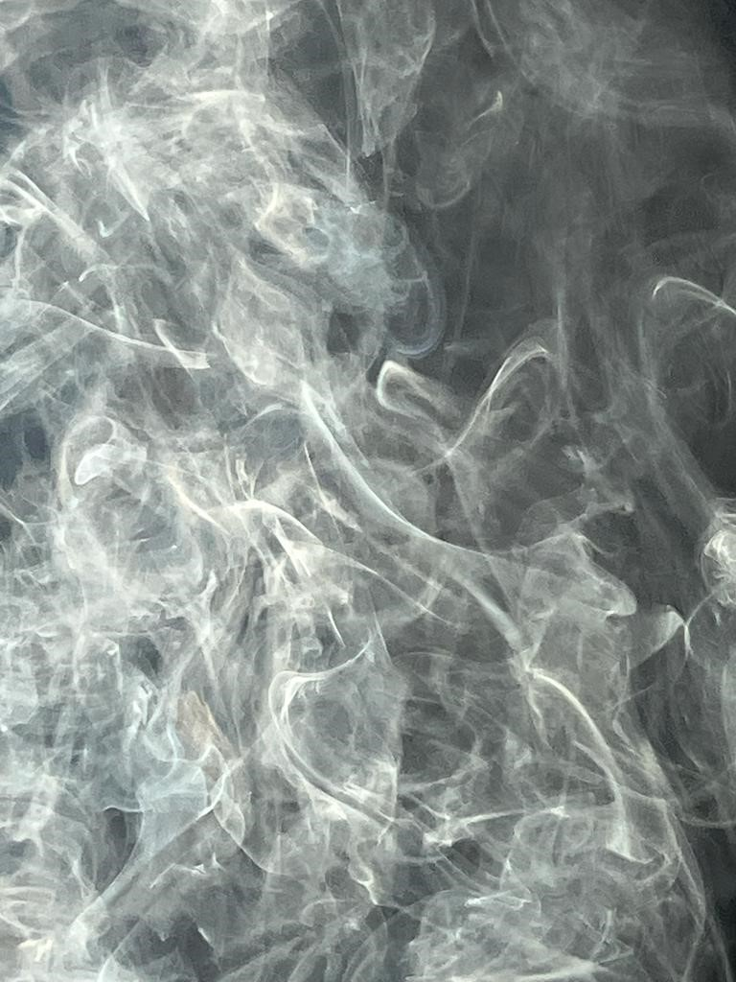
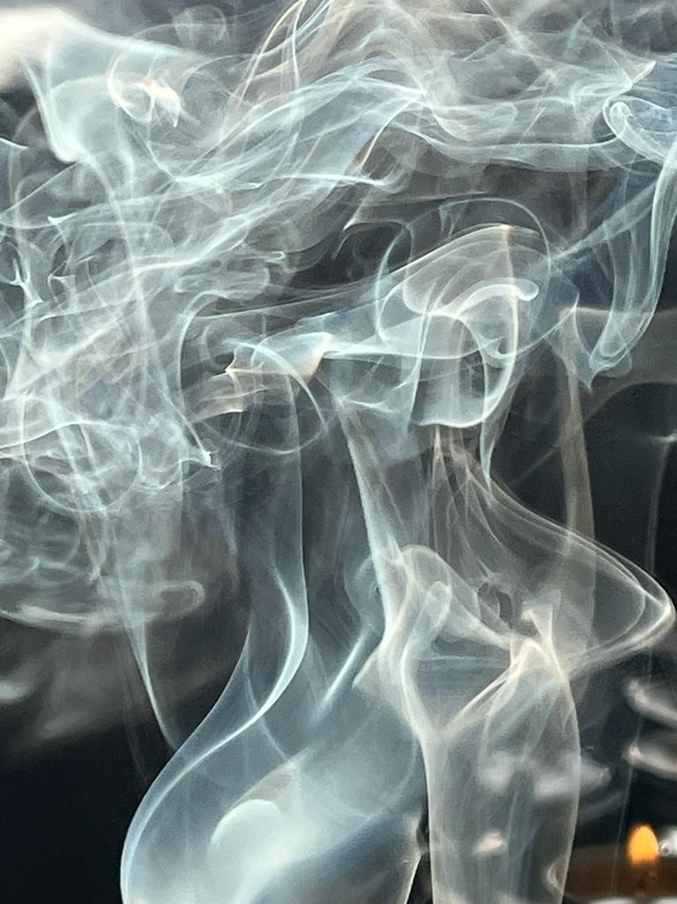
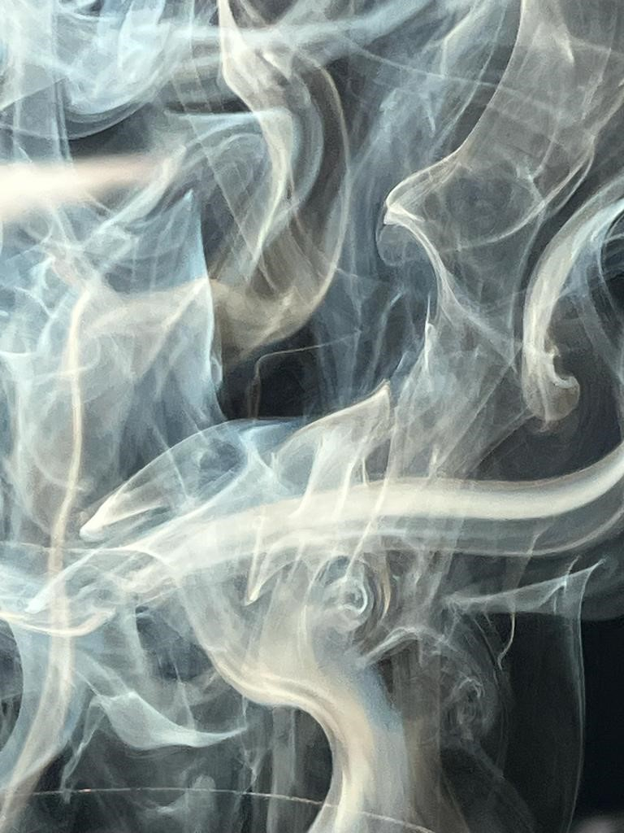
MINI SHOOT SMOKE - UNEDITED

Slide 4
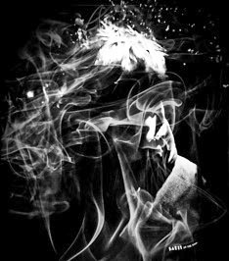
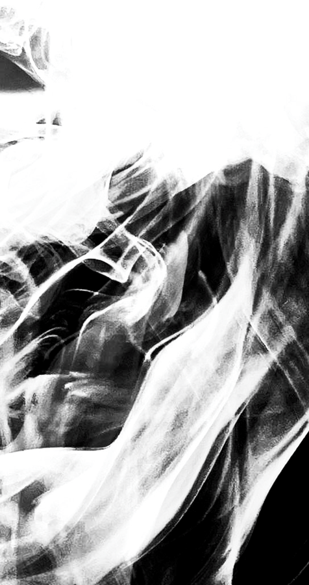
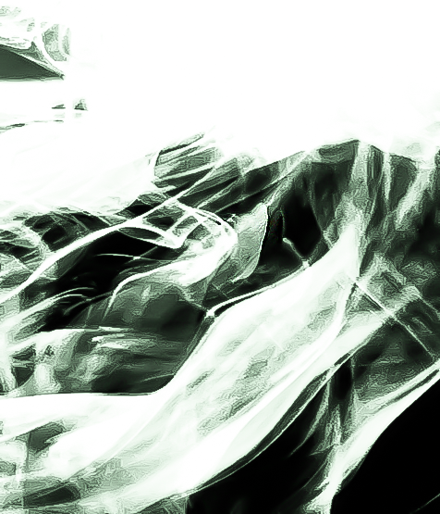
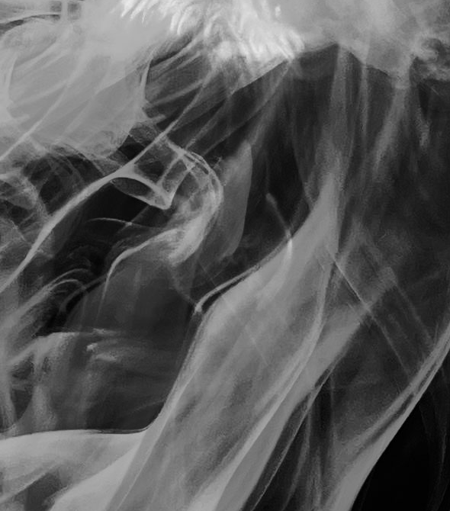
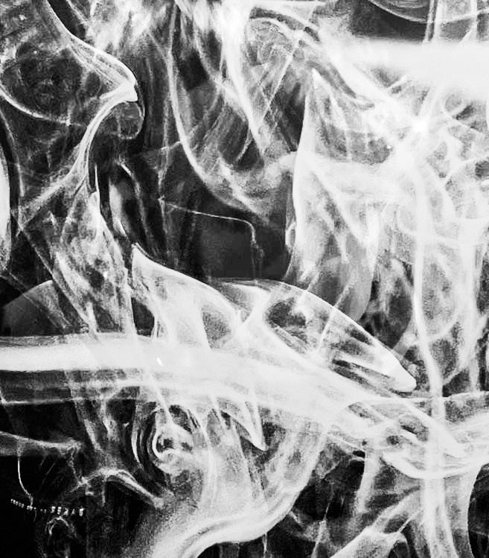
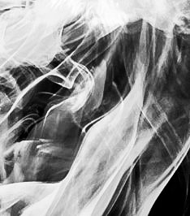
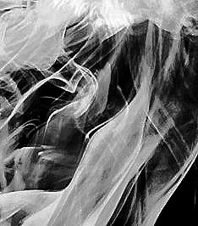
MINI SMOKE SHOOT
Edited images

Slide 5
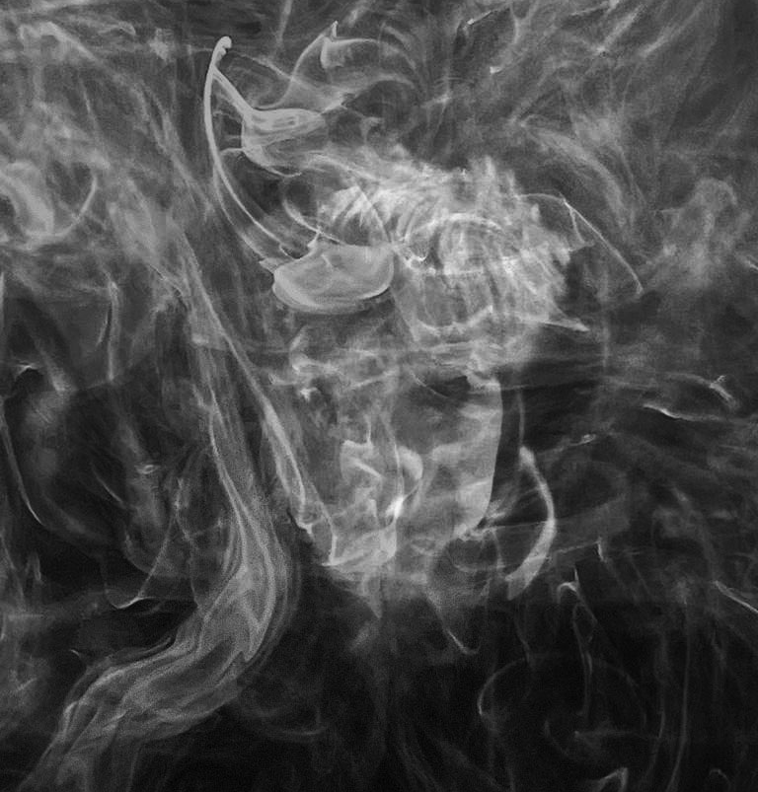
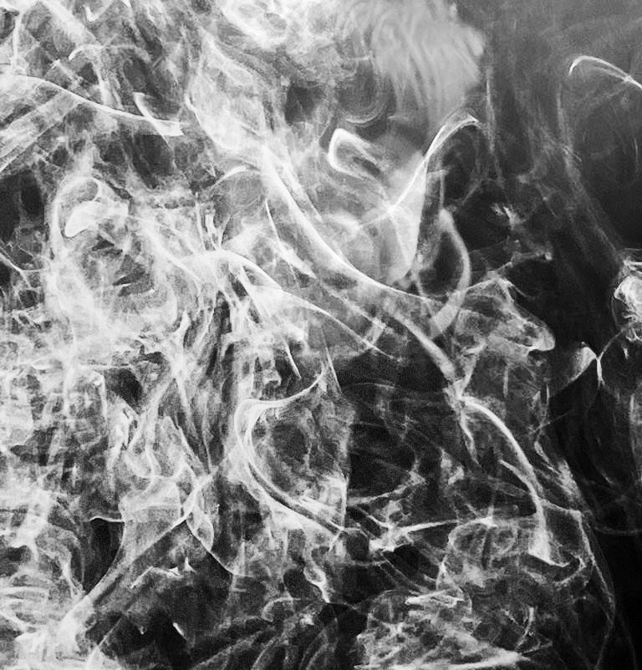
CONTINUATION OF SMOKE SHOOT MINI EDITS

Slide 6
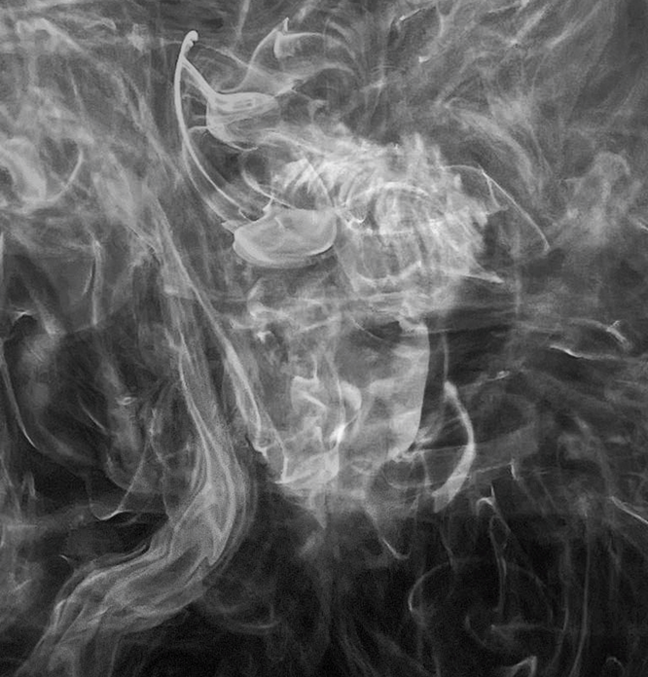
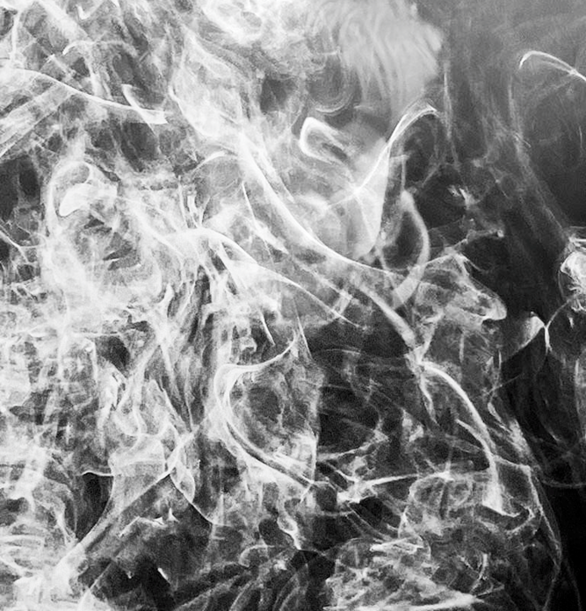
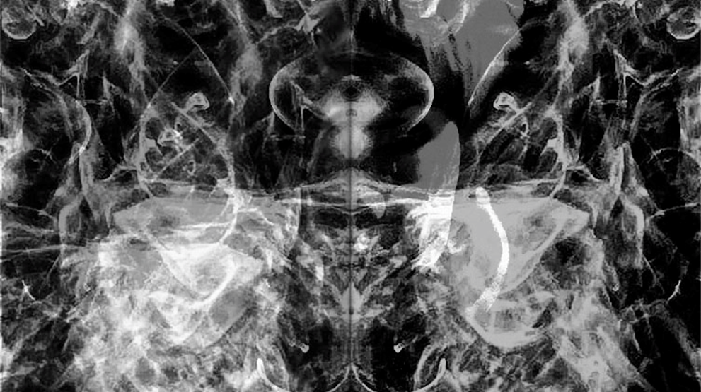
SMOKE SHOOT MINI PROJECT EVALUATION
This shoot overall was okay, it did not come out in how I typically viewed it in my head to be but on the contrary there is many successes with this mini project. For example an improvement I would make if I retook this shoot would be the editing side where the overlaying went a bit fuzzy and I would want to make it clearer and more crisp, concealing the face but have more of it showing than the outline.
However, on the other hand, my successes were as I dove deeper into the editing process more and more of my edits were coming into my vision, where the face was concealed but with more showing than the silhouette. Furthermore, the images of the smoke I took was in a visit to Berwick Church was powerful and detailed alongside this I played around with the shutter speed to capture more movement of the smoke to give it more depth.
These are my favourite outcomes because: they conceal, hide and manipulate the image bringing together my complete want from this shoot. Though the editing process was hard, I find these the most successful and powerful.

