Slide 2
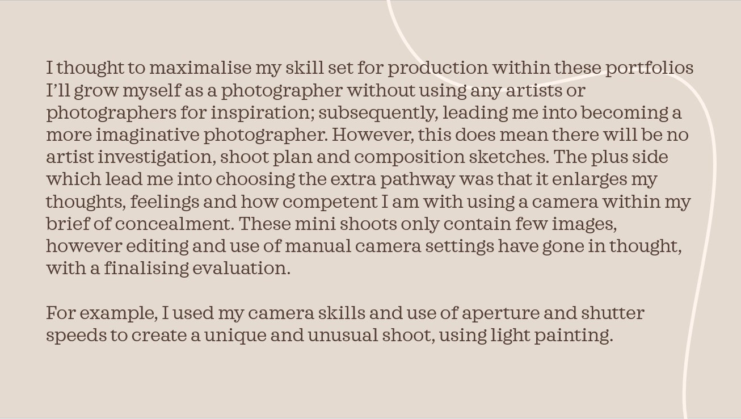

Slide 3
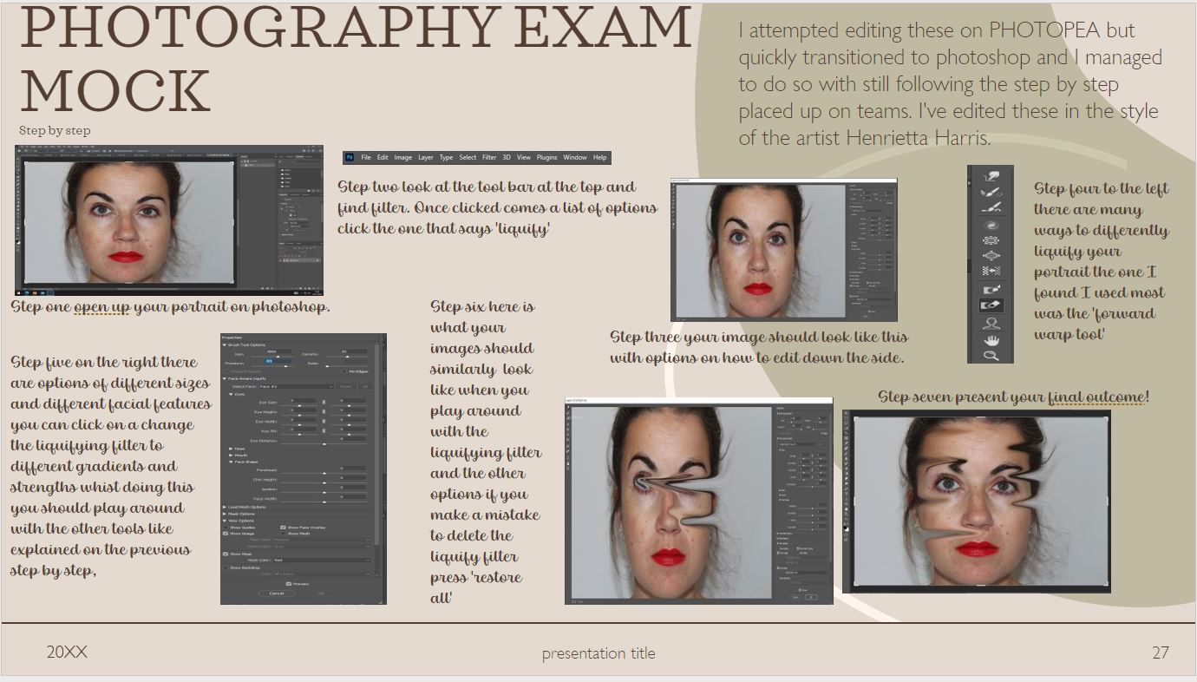

Slide 4
I believe these were my most successful images for many reasons due to the fact I think it’s a unique take on concealment and the contrast of colours is bold and its powerful yet minimalistic.

