Slide 1
UNEDITED IMAGES FOR SHOOT INSPIRED BY JACK DAVISON
IN SCHOOL SHOOT CHOSEN IMAGES
IN SCHOOL SHOOT CHOSEN IMAGES
IN SCHOOL SHOOT CHOSEN IMAGES

Slide 2
SHADOWS CONTINUATION EDITED
EDITED BY CAMERA RAW FILTER
EDITED BY CAMERA RAW FILTER
EDITED BY CAMERA RAW FILTER

Slide 3
UNEDITED IMAGES FOR SHOOT INSPIRED BY JACK DAVISON
IN SCHOOL SHOOT CHOSEN IMAGES
IN SCHOOL SHOOT CHOSEN IMAGES
IN SCHOOL SHOOT CHOSEN IMAGES

Slide 4
SHADOWS CONTINUATION EDITED
EDITED BY CAMERA RAW FILTER
EDITED BY CAMERA RAW FILTER
EDITED BY CAMERA RAW FILTER

Slide 5
UNEDITED IMAGES FOR SHOOT INSPIRED BY JACK DAVISON
ISO 500 f1.6 1/42s
ISO 640 F1.6 1/37S
ISO 1000 F1.6 1/27S
These were shot on my cannon EOS 700D in manual

Slide 6
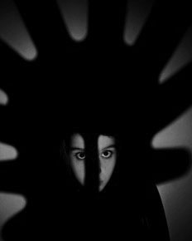
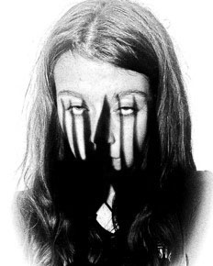
SHADOWS CONTINUATION EDITED
EDITED BY CAMERA RAW FILTER
EDITED BY CAMERA RAW FILTER
EDITED BY CAMERA RAW FILTER

Slide 7
UNEDITED IMAGES FOR SHOOT INSPIRED BY JACK DAVISON
These were shot on my cannon EOS 700D in manual
ISO 640 F1.6 1/30S
ISO 1250 F1.6 1/9S
ISO 500 F1.6 1/25S

Slide 8
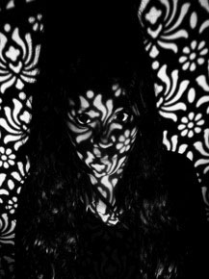
SHADOWS CONTINUATION EDITED
EDITED BY CAMERA RAW FILTER
EDITED BY CAMERA RAW FILTER
EDITED BY CAMERA RAW FILTER

