Slide 1
CONCEALMENT PORTFOLIO 1.5 EXPERIMENTING AS A PHOTOGRAPHER - Lily Prosser

Slide 2
I thought to maximalise my skill set for production within these portfolios I’ll grow myself as a photographer without using any artists or photographers for inspiration; subsequently, leading me into becoming a more imaginative photographer. However, this does mean there will be no artist investigation, shoot plan and composition sketches. The plus side which lead me into choosing the extra pathway was that it enlarges my thoughts, feelings and how competent I am with using a camera within my brief of concealment. These mini shoots only contain few images, however editing and use of manual camera settings have gone in thought, with a finalising evaluation.
For example, I used my camera skills and use of aperture and shutter speeds to create a unique and unusual shoot, using light painting.

Slide 3
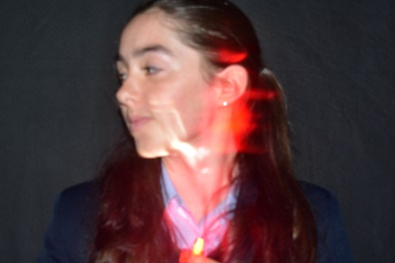
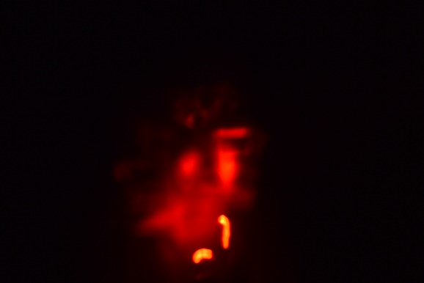
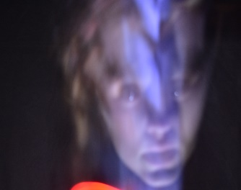
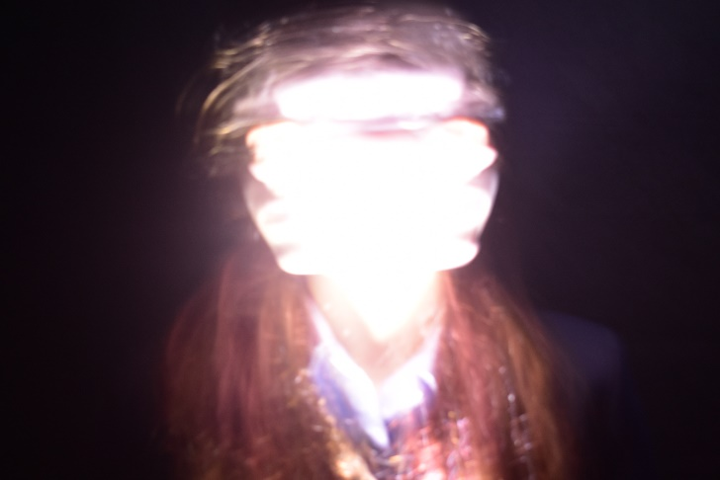
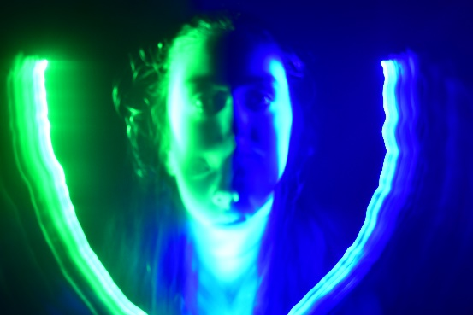
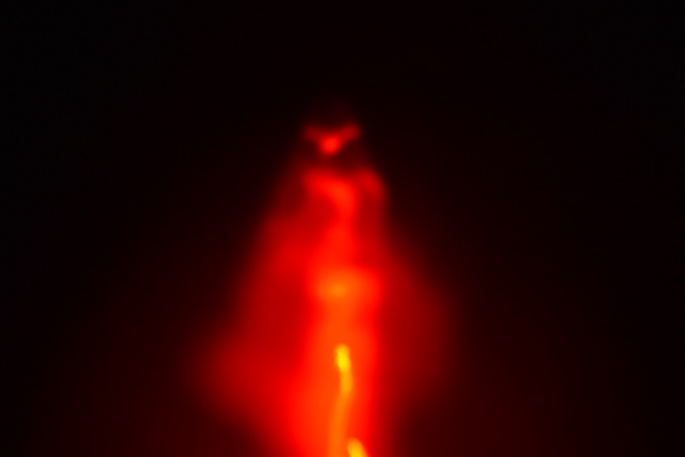
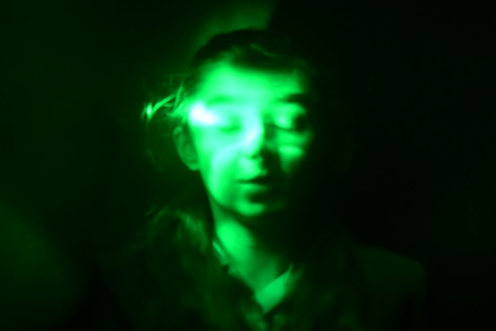
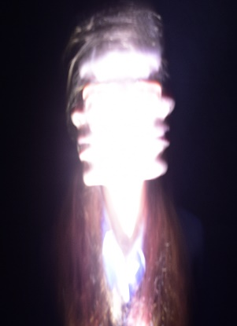
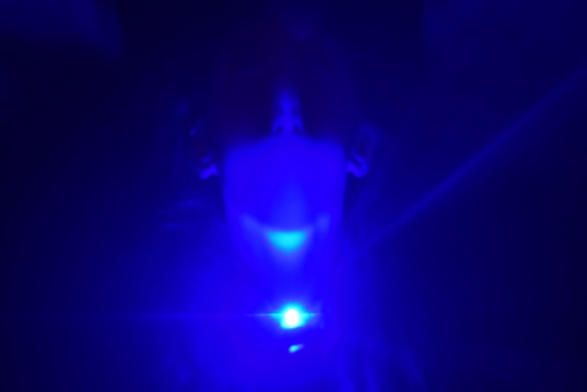
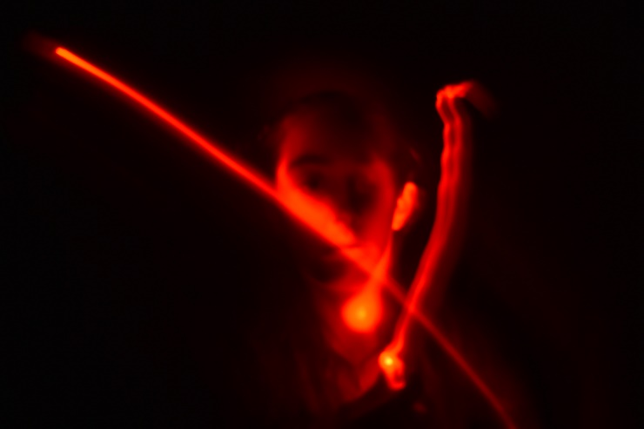
First In School Shoot - Light painting.

