Slide 1
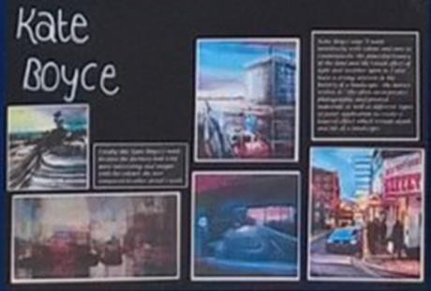
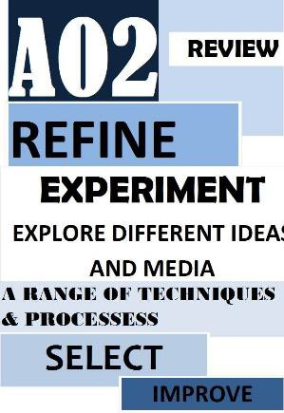
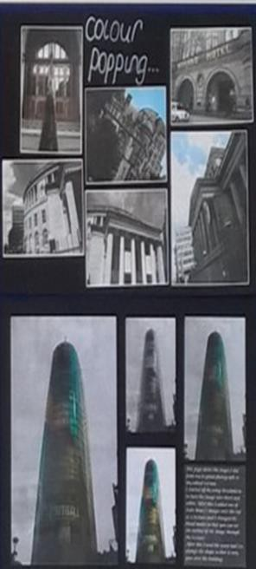
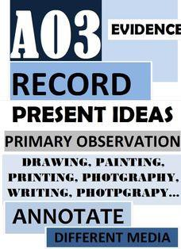
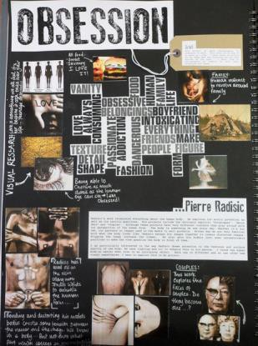
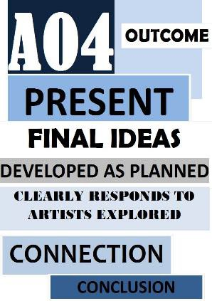
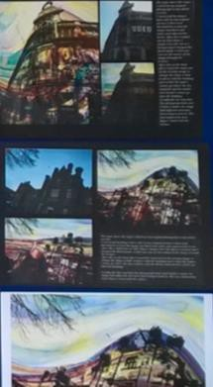
GCSE PHOTOGRAPHY - KNOWLEDGE ORGANISER
Assessment Objectives
This is how you are marked for coursework and Exam.
There are 25 marks to gain for each AO.
60% of your GCSE mark is coursework and 40% is your exam mark.
AO1 Develop ideas through investigations Scan here for more advice on AO1 |  | Artist research pages. Visits to exhibitions and galleries. Your own responses in the style of the artist. Interviews with artists/ photographers. Annotate and analyse what you have found out.
AO2 |  | Experimenting with a range of different materials and techniques. Photo-shoots exploring different techniques. Selecting best photographs from Photo-shoots. Using Photo-shop to edit photographs further in a creative way. Using Darkroom processes to create photograms/ cyanotypes/ Double exposures.
Refine work by exploring
ideas and selecting and
experimenting with
appropriate techniques.
Scan here
for more
advice on
AO2
AO3 Record ideas, observations and insights relevant to their intentions in visual and/or other forms. |  | Title page. Mind Map. Mood-boards. Planning Photo-shoots. Photographs. Contact sheets of Photo-
 |  | shoots.
Scan here
for more
advice on
AO3
AO4 |  | Plans and drawings of final piece ideas. Mini mock-ups and experiments for final piece. Creating an original final piece, that is clearly inspired by your research and creative journey. Evaluation of final piece (how does your piece link to the project theme?).
Present a personal,
informed and meaningful
response. Completing a
relevant and intentional
final piece.
Scan here
for more
advice on
AO4

Slide 2
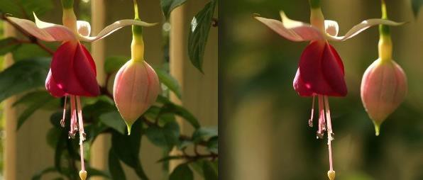
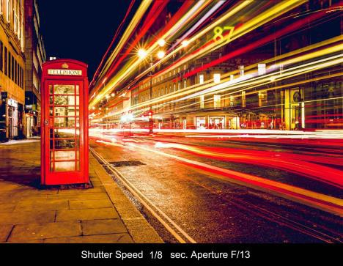
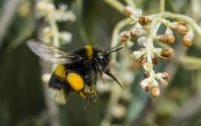
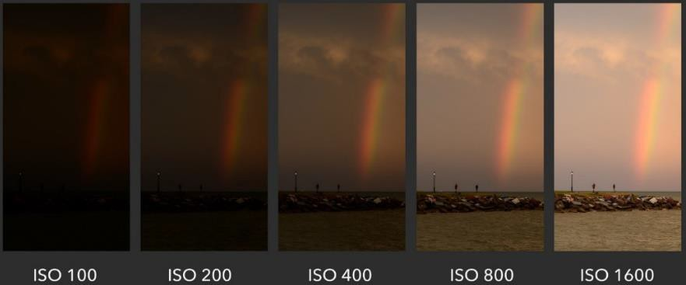
GCSE PHOTOGRAPHY - KNOWLEDGE ORGANISER
Manual Camera Settings
Gives you complete control of the camera. Can be accessed on a DSLR by selecting M.
Involves the Exposure Triangle – Aperture / ISO/ Shutter Speed
If one of the exposure triangle setting is changed it will affect the other two.
For hints and tips on how to do a photo-shoot go to Student Share / Art / GCSE Photography / How to do a photo-shoot.
Aperture:
How open the lens is.
To capture close up shots a wider lens is required.
To capture detail in the distance a smaller lens setting is required.
Scan here for an introduction to using Aperture settings
Shutter Speed:
How quickly the shutter
opens and closes.
Used for action and movement shots.
The slower the setting the more blurred the photograph.
Scan here for an introduction to using Shutter Speed settings
ISO:
How much light is let into the camera.
Can affect the photograph by making it grainy the higher the setting.
Scan here for an introduction to using ISO settings

Slide 3
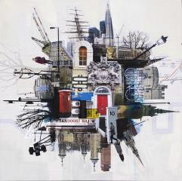
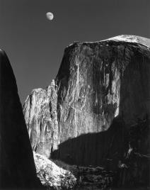
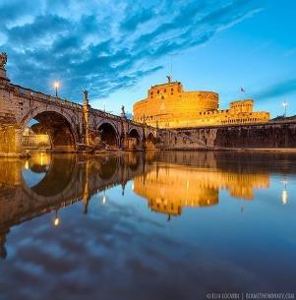
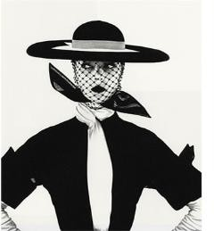
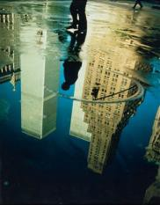
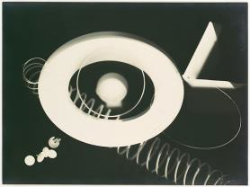
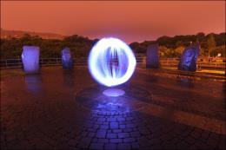
GCSE PHOTOGRAPHY - KNOWLEDGE ORGANISER
Compositional Elements
Key things to consider when setting up a shot.
Used to describe how a photograph works.
Are not all used at the same time. However some can be more prominent than others in a photograph.
Pattern | There are patterns all around us if we only learn to see them. Emphasizing and highlighting these patterns can lead to striking shots – as can high lighting when patterns are broken. |  | JON MEASURES
Texture | Photographs of two dimensional objects yet with the clever use of ‘texture’ they can come alive and become almost three dimensional. You want the viewer to imagine how the object feels. |  | ANSEL ADAMS
Depth of Field | The depth of field that you select when taking an image will drastically impact the composition of an image. It can isolate a subject from its background and foreground (when using a shallow depth of field) or it can put the same subject in context by revealing it’s surrounds with a larger depth of field. |  | ELIA LOCARDI
Symmetry | Can create a balanced composition that leaves the viewer with a feeling the photograph is staged in some way. Can add a striking effect depending on the subject/ object photographed. |  | IRVING PENN
Rule of Thirds | A 3x3 grid used by photographs to create a composition that feels right. Objects that fall on or near the lines are considered to have the best impact. |  | ERNST HAAS
Shape | The way subjects connect to each other in a photo forms shapes that draw the eye from subject to subject. If your subject is already triangular or diamond-shaped (like a pyramid), the viewer's eye will automatically focus on that shape. |  | MAN RAY
Focal Point/ | The main focus of a photograph/artwork. There is usually a line/ shape/ space of some form leading to it. |  | MICHAEL BOSANKO

Slide 4
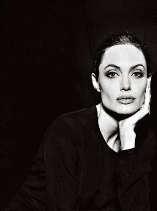
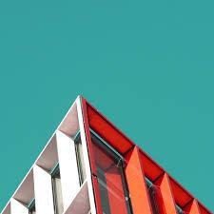
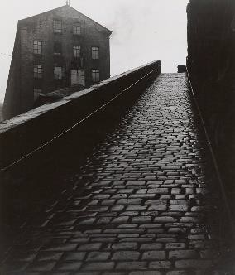
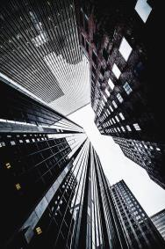
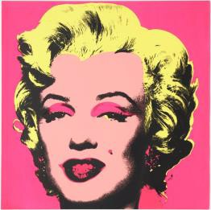
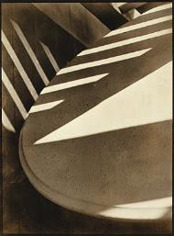
GCSE PHOTOGRAPHY - KNOWLEDGE ORGANISER
Compositional Elements
Key things to consider when setting up a shot.
Used to describe how a photograph works.
Are not all used at the same time. However some can be more prominent than others in a photograph.
Restful / Dynamic Composition | If there is space around an object in a composition then it is considered restful. Photographs that are zoomed in and objects touch the edges of the composition are considered dynamic. It dictates how much the viewer’s eyes have to move around the photograph to see everything. |  | ANNIE LEIBOVITZ
Simplification | When light, depth of field, positioning of an object is used to make the viewer focus on a specific area of the photograph/artwork. |  | NICHOLAS GOODDEN
Lines (Horizon line) | Lines can be powerful elements in an image. They have the power to draw the eye to key focal points in a shot and to impact the ‘feel’ of an image greatly. Diagonal, Horizontal, Vertical and Converging lines all impact images differently and should be spotted while framing a shot and then utilized to strengthen it. |  | BILL BRANDT
Viewpoint/ Perspective | Birds- eye: From above facing downward Worm’s – eye: From below facing upward Eye – line: At standing height These perspectives can have an impact on how the viewer feels about the photograph, and how it is perceived. |  | ANTONIO JAGGIE
Colour | A lot of colour can be overwhelming and considered a bold statement. Lack of colour can focus the viewer on the message the photographer is trying to convey. Lack of colour can also accentuate the patterns, shapes and textures in a photograph. |  | ANDY WARHOL
Abstract | It is taking a subject and forcing the viewer to look at it in a different way. This may cause the subject to lose its original meaning or purpose. It may even render the subject unreal, abnormal and not of this world. The subject could lose all literal meaning and be reduced to only shape, light, texture or color. |  | PAUL STRAND

Slide 5
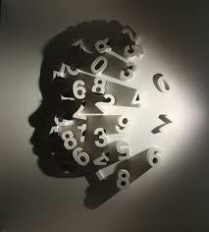
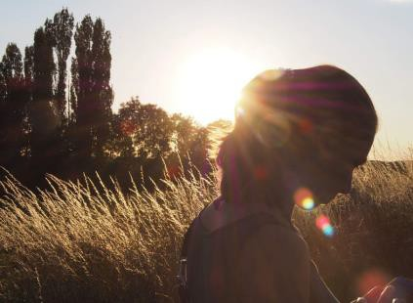
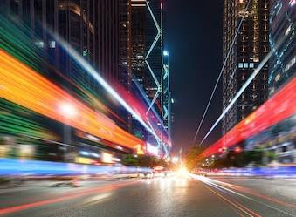
GCSE PHOTOGRAPHY - KNOWLEDGE ORGANISER
Light
Can be used to create shadow or highlight an object/person.
Comes in many different forms.
Use of light can have an impact on camera settings.
Direction of the light source is very important.
Shadow Art by
Kumi Yamashita
Scan here for an introduction to using light in photography
Natural Light
Artificial Light
Helpful Websites for GCSE Photography
Website | QR Code | Summary
https://digital-photography- school.com/digital-photography-tips-for- beginners/ |  | Really informative website with lots of easy to follow tutorials for beginners in photography.
https://www.bbc.com/bitesize/guides/zg wpnbk/revision/1 |  | GCSE Bitesize website is great for video tutorials, subject specific vocab and helping to understand how GCSE Photography course works.
https://www.tate.org.uk/ |  | The Tate website is a fantastic resource for finding out about exhibitions you could visit for primary research (AO1).
Photoshop
Used to enhance and creatively edit digital photographs.
Always take screenshots using the “Snipping Tool” to evidence what you have done while editing.
Only use specific features and effects if there is a link to research. Not every Photograph needs to be edited.
To find a digital guide to the basic skills for using Photoshop go to:
Student Share / Art / GCSE Photography / Basic Photoshop Skills

